Slide 1

William Stallings Computer Organization and Architecture 11th Edition

Slide 2
Chapter 4
Memory Hierarchy
Notes:
Although seemingly simple in concept, computer memory exhibits perhaps the widest
range of type, technology, organization, performance, and cost of any feature
of a computer system. No single technology is optimal in satisfying the memory
requirements for a computer system. As a consequence, the typical computer
system is equipped with a hierarchy of memory subsystems, some internal to the
system (directly accessible by the processor) and some external (accessible by the
processor via an I/O module).
This chapter and the next focus on internal memory elements, while Chapter 6
is devoted to external memory. To begin, the first section examines key characteristics
of computer memories. The remainder of the chapter examines an essential element
of all modern computer systems: cache memory.

Slide 3
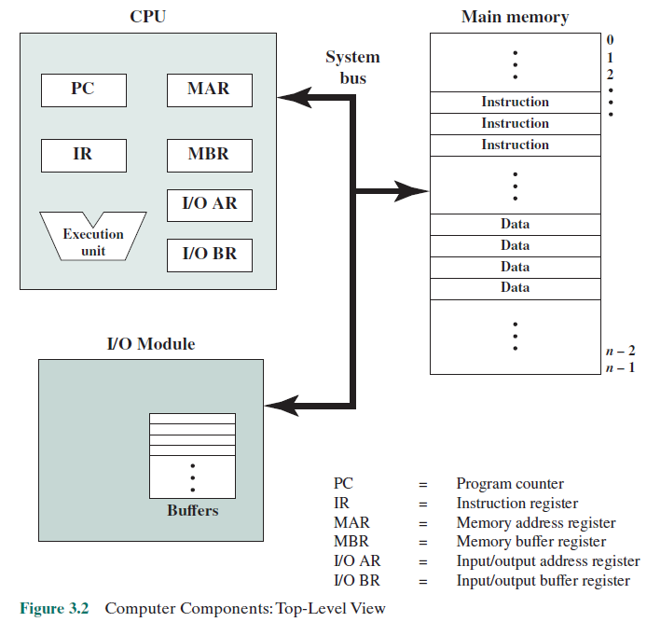
Computer Components

Slide 4
4.1 Principle of Locality

Slide 5
Memory
Typical computer system is equipped with a hierarchy of memory subsystems, some internal to the system (directly accessible by the processor) and some external (accessible by the processor via an I/O module).
Focus of this chapter is Internal Memory Elements

Slide 6
Principle of Locality
Locality of Reference
During execution of a program, memory referenced by a program for both instructions and data, are in a cluster
Loop: within a loop, only a small set of instructions are repeated
Tables/Arrays: only a small cluster of data is referenced
Over a long period of execution, the clusters change but over a short period, the processor is working with a fixed clusters of memory references

Slide 7
Locality is based on three assertions
During any interval of time, a program references memory locations non-uniformly. That is, some units of memory are more likely to be accessed than others.
As a function of time, the probability that a given unit of memory is referenced tends to change slowly. Put another way, the probability distribution of memory references across the entire memory space tends to change slowly over time.
The correlation between immediate past and immediate future memory reference patterns is high, and tapers off as the time interval increases.

Slide 8
Temporal Locality
Temporal locality: tendency of a program to reference in the near future those units of memory referenced in the recent past.
For example, when an iteration loop is executed, the processor executes the same set of instructions repeatedly. Constants, temporary variables, and working stacks are also constructs that lead to this principle.

Slide 9
Spatial Locality
Spatial locality: tendency of a program to reference units of memory whose addresses are near one another. That is, if a unit of memory x is referenced at time t, it is likely that units in the range x - k through x + k will be referenced in the near future, for a relatively small value of k.
This reflects the tendency of a processor to access instructions sequentially. Spatial location also reflects the tendency of a program to access data locations sequentially, such as when processing a table of data.

Slide 10
Application of Temporal and Spatial Locality
How to use these?
For cache memory, temporal locality is traditionally exploited by keeping recently used instruction and data values in cache memory and by exploiting a cache hierarchy.
Spatial locality is generally exploited by using larger cache blocks and by incorporating prefetching mechanisms (fetching items of anticipated use) into the cache control logic.

Slide 11
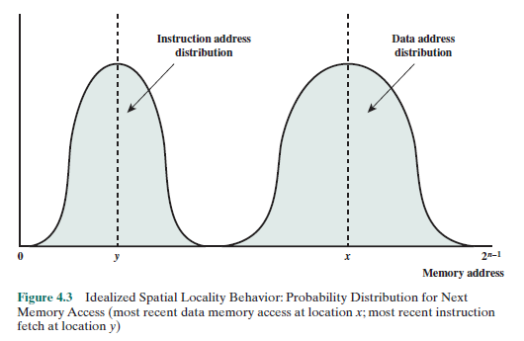
Distribution of data location accesses vs. instruction fetch addresses
There is less variance in Instruction addresses than in Data addresses

Slide 12
Types of Instructions
Static Instructions vs Dynamic Instructions
Static instruction: An instruction that exists in the code to be executed. Examples of static instructions include variable declarations, constant assignments, and function definitions.
Dynamic instruction: Instructions that appear in the execution trace of a program. Examples of dynamic instructions include if-else statements, while loops, and switch statements, where the path of execution is determined based on runtime conditions or variables.
Dynamic instructions are essential for implementing program logic that responds to changing inputs and conditions, while static instructions provide the foundational structure and operations of a program.

Slide 13
4.2 Characteristics of Memory Systems

Slide 14
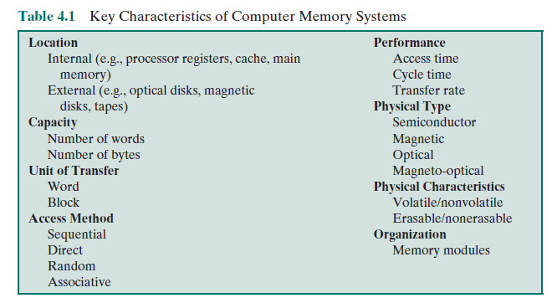
Memory
Table 4.1
Key Characteristics of Computer Memory Systems

Slide 15
Characteristics of Memory Systems
Location
Refers to whether memory is internal and external to the computer
Internal memory is often equated with main memory
Processor requires its own local memory, in the form of registers
Cache is another form of internal memory
External memory consists of peripheral storage devices that are accessible to the processor via I/O controllers such as optical and magnetic disks etc
Capacity
Memory is typically expressed in terms of bytes or words
Unit of transfer
For internal memory, the unit of transfer is equal to the number of electrical lines into and out of the memory module such as word, block
Notes:
The term location in Table 4.1 refers to whether memory is internal and external
to the computer. Internal memory is often equated with main memory. But there
are other forms of internal memory. The processor requires its own local memory, in
the form of registers (e.g., see Figure 2.3). Further, as we shall see, the control unit
portion of the processor may also require its own internal memory. We will defer
discussion of these latter two types of internal memory to later chapters. Cache is
another form of internal memory. External memory consists of peripheral storage
devices, such as disk and tape, that are accessible to the processor via I/O controllers.
An obvious characteristic of memory is its capacity. For internal memory, this is
typically expressed in terms of bytes (1 byte = 8 bits) or words. Common word lengths
are 8, 16, and 32 bits. External memory capacity is typically expressed in terms of bytes.
A related concept is the unit of transfer. For internal memory, the unit
of transfer is equal to the number of electrical lines into and out of the memory
module. This may be equal to the word length, but is often larger, such as 64, 128, or
256 bits. To clarify this point, consider three related concepts for internal memory:
• Word: The “natural” unit of organization of memory. The size of a word is typically
equal to the number of bits used to represent an integer and to the instruction
length. Unfortunately, there are many exceptions. For example, the CRAY
C90 (an older model CRAY supercomputer) has a 64-bit word length but uses
a 46-bit integer representation. The Intel x86 architecture has a wide variety of
instruction lengths, expressed as multiples of bytes, and a word size of 32 bits.
• Addressable units: In some systems, the addressable unit is the word. However,
many systems allow addressing at the byte level. In any case, the relationship
between the length in bits A of an address and the number N of addressable
units is 2^{A} = N.
• Unit of transfer: For main memory, this is the number of bits read out of or
written into memory at a time. The unit of transfer need not equal a word or
an addressable unit. For external memory, data are often transferred in much
larger units than a word, and these are referred to as blocks

Slide 16
Access Methods
Sequential access
Memory is organized into units of data, called records.
Access must be made in a specific linear sequence.
Stored addressing information is used to separate records and assist in the retrieval process.
A shared read–write mechanism is used, and this must be moved from its current location to desired location
Time to access is highly variable

Slide 17
Access Methods
Direct access
As with sequential access, direct access involves a shared read–write mechanism.
However, individual blocks or records have a unique address based on physical location.
Access is accomplished by direct access to reach a general vicinity plus sequential searching, counting, or waiting to reach the final location.
Again, access time is variable.

Slide 18
Access Methods
Random access
Each addressable location in memory has a unique, physically wired-in addressing mechanism.
The time to access a given location is independent of the sequence of prior accesses and is constant.
Thus, any location can be selected at random and directly addressed and accessed.
Main memory and some cache systems are random access.

Slide 19
Access Methods
Associative
This is a random access type of memory that enables one to make a comparison of desired bit locations within a word for a specified match, and to do this for all words simultaneously.
Thus, a word is retrieved based on a portion of its contents rather than its address.
As with ordinary random-access memory, each location has its own addressing mechanism, and retrieval time is constant independent of location or prior access patterns.
Cache memories may employ associative access.

Slide 20
Performance and Capacity
Three performance parameters are used:
Access time (latency)
Memory cycle time
Transfer rate
Notes:
From a user’s point of view, the two most important characteristics of memory
are capacity and performance. Three performance parameters are used:
• Access time (latency): For random-access memory, this is the time it takes to
perform a read or write operation, that is, the time from the instant that an
address is presented to the memory to the instant that data have been stored
or made available for use. For non-random-access memory, access time is the
time it takes to position the read–write mechanism at the desired location.
• Memory cycle time: This concept is primarily applied to random-access memory
and consists of the access time plus any additional time required before a second
access can commence. This additional time may be required for transients to die
out on signal lines or to regenerate data if they are read destructively. Note that
memory cycle time is concerned with the system bus, not the processor.
• Transfer rate: This is the rate at which data can be transferred into or out of a
memory unit. For random-access memory, it is equal to 1/(cycle time).

Slide 21
Performance Parameters of Memory
Access time (latency)
For random-access memory it is the time it takes to perform a read or write operation
For non-random-access memory it is the time it takes to position the read-write mechanism at the desired location

Slide 22
Performance Parameters of Memory
Memory cycle time
Access time plus any additional time required before second access can commence
Additional time may be required for transients to die out on signal lines or to regenerate data if they are read destructively
Concerned with the system bus, not the processor

Slide 23
Performance Parameters of Memory
Transfer rate
The rate at which data can be transferred into or out of a memory unit
For random-access memory it is equal to 1/(cycle time)
For non-random access, it is
Tn = Ta + n/R
Tn is avg time to read or write n bits
Ta is avg access time
n is number of bits
R is Transfer rate in bits per second

Slide 24
Physical Type and Form Memory
The most common forms are:
Semiconductor memory
Magnetic surface memory
Optical
Magneto-optical
Several physical characteristics of data storage are important:
Volatile memory
Information decays naturally or is lost when electrical power is switched off
Nonvolatile memory
Once recorded, information remains without deterioration until deliberately changed
No electrical power is needed to retain information
Magnetic-surface memories
Are nonvolatile
Semiconductor memory
May be either volatile or nonvolatile
Nonerasable memory
Cannot be altered, except by destroying the storage unit
Semiconductor memory of this type is known as read-only memory (ROM)
For random-access memory the organization is a key design issue
Organization refers to the physical arrangement of bits to form words
Notes:
A variety of physical types of memory have been employed. The most common
today are semiconductor memory, magnetic surface memory, used for disk and
tape, and optical and magneto-optical.
Several physical characteristics of data storage are important. In a volatile
memory, information decays naturally or is lost when electrical power is switched
off. In a nonvolatile memory, information once recorded remains without deterioration
until deliberately changed; no electrical power is needed to retain information.
Magnetic-surface memories are nonvolatile. Semiconductor memory (memory
on integrated circuits) may be either volatile or nonvolatile. Nonerasable memory
cannot be altered, except by destroying the storage unit. Semiconductor memory of
this type is known as read-only memory (ROM). Of necessity, a practical nonerasable
memory must also be nonvolatile.
For random-access memory, the organization is a key design issue. In this context,
organization refers to the physical arrangement of bits to form words. The
obvious arrangement is not always used, as is explained in Chapter 5.

Slide 25
Today’s Class
4.1 and 4.2

